Slide 1
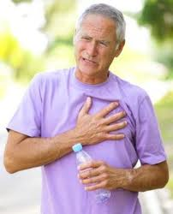
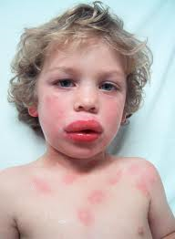
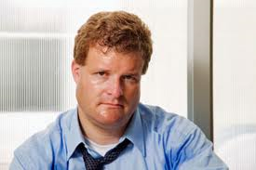
Circulation Emergencies

Slide 2
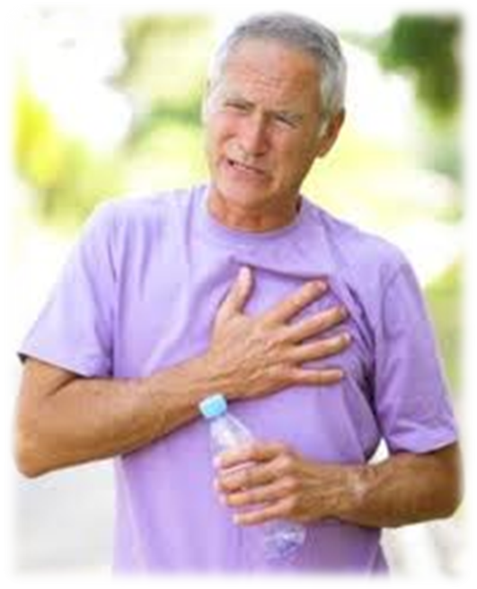
68 Year Old Man
Chest pain
Started at work while at his desk.
CP 2 weeks ago but it went away on its own.
Brother died of a heart attack 2 years ago.
Just had an MD check up and was told he was healthy!

Slide 3
Assessment
ONSET- At rest, at his desk, moderate amount of stress
PROVOKE – Doesn’t change with breath or movement but doesn’t get better either
QUALITY – Tight & Pressure
RADIATE – Maybe a bit into his shoulder
SEVERITY – 8/10
TIMING - Constant
AIRWAY – Talking
BREATHING – Spontaneous, a bit labored and a bit rapid.
CIRCULATION – pale and diaphoretic
DISABILITY - Alert

Slide 4
3 System Approach
Associated with food? Pink Lady?
Hurt to take deep breath? SOB? Can you walk a block? Sleep lying flat?
Were you working out? Did you fall? Shoveling? Strain?
Nausea, Diaphoresis, radiation, OPQRST History of Cardiac?
GI
Resp
Musculoskeletal
Cardiac

Slide 5
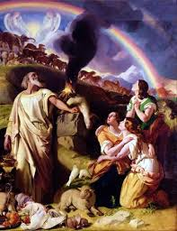

NOW WHAT?
NOAH
MONA

Slide 6
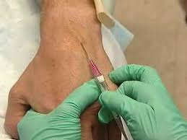
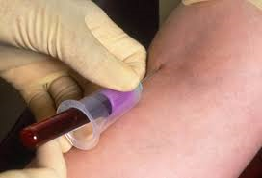
BUT WAIT! There’s more!
Can’t give Nitro until…
While your there…

Slide 7
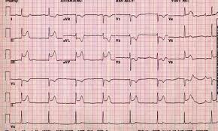
MOST IMPORTANTLY!

